Slide 1
CoMeet
Presented By:
Baibhav Poudel
Anoj Aryal
Krishal Pudasaini
Santosh Tamang

Slide 2
Requirement Analysis
Functional Requirement
Users must register.
Users must log in to use the features.
Users may start texting or video chatting.
Non-Functional Requirement
The system must be online 24/7.
The system must be platform-independent.
The system should respond as fast as possible.
Future amendment must be allowed.

Slide 3
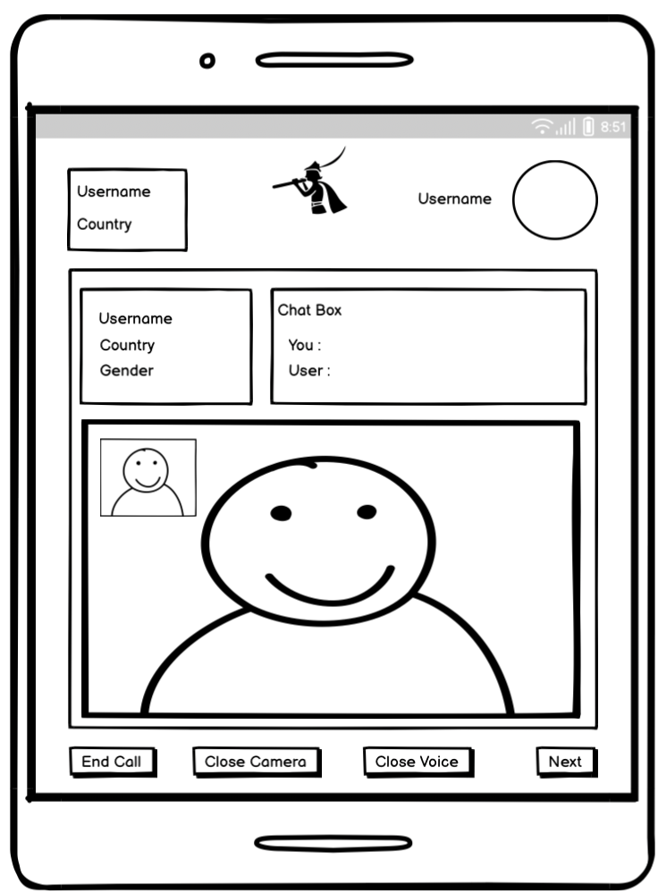
Design

